Slide 1
Battle of the Neighborhoods
Week 2

Slide 2
Target Audience
Our target audience and stakeholders are companies and individuals who wish to open new restaurant premises on the city of Santa Monica’s popular City Center. However that is not a straightforward process, for reasons I will next explain. The pitfalls are mainly competition, cost of operating a business, cultural differences that exist in some areas, and the demographic makeup of some localities. Thus the clients require an analysis of the local neighborhoods to understand the scope of the issues. Some types of restaurants are better suited to particular areas.

Slide 3
Demographics of the City
The population of the City of Santa Monica, California is an estimated 91,577 . Santa Monica is a cosmopolitan city with a broad mixture of Americans and immigrants from other countries. The demographic makeup of the people in the city are of mainly White, African Americans, Hispanic or Latino, and Native Americans. Naturally there is much choice of restaurants, serving both Domestic and foreign foods.

Slide 4
Breakdown of the Customer base
Santa Monica Demographics
• White: 75.9% (64.6% non-Hispanic)
• Black or African American: 4.5%
• American Indian: 0.3%
• Asian: 10.2%
• Pacific Islander: 0.1%
• Two or more races: 5.9%
• Hispanic of any race: 15.4%

Slide 5
Business Opportunities
Since Santa Monica is such a multicultural and eclectic hub, with a large workforce available, the city offers many business opportunities which groups of investors can exploit. The downside is, that since there are many restaurants there already, hence the competition for customers is considerable. Property in the City Center area is also expensive and suffers from being heavily taxed. The cost of trading in Santa Monica, therefore requires to be thoroughly analyzed and considered before any new company can be opened. In this analysis we will attempt to find the best location for the new business, by examining what already exists in the chosen area. In particular we will be looking at the City Center area of the city.

Slide 6
The data that will be used to solve the problem:
We will be using Foursquare and geopy data to map top the top venues within the location of Santa Monica’s City Center to indicate what venues already exist in this popular area. We will create a map of the area covering about 5000m.

Slide 7
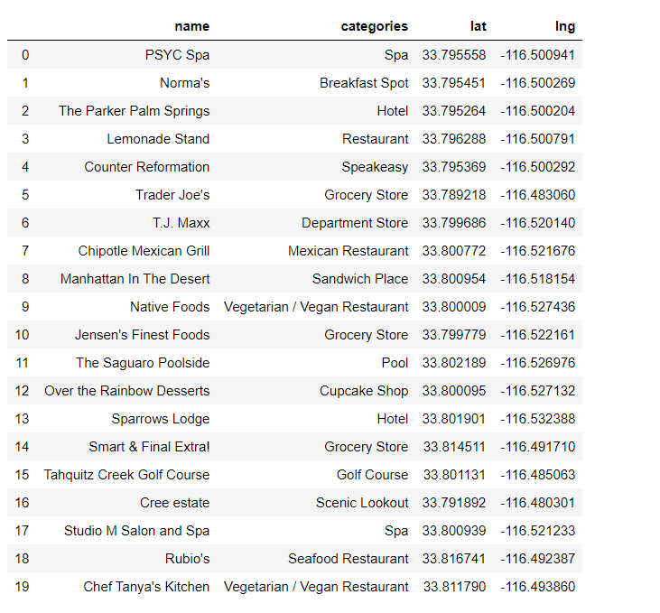
Sample Data

Slide 8
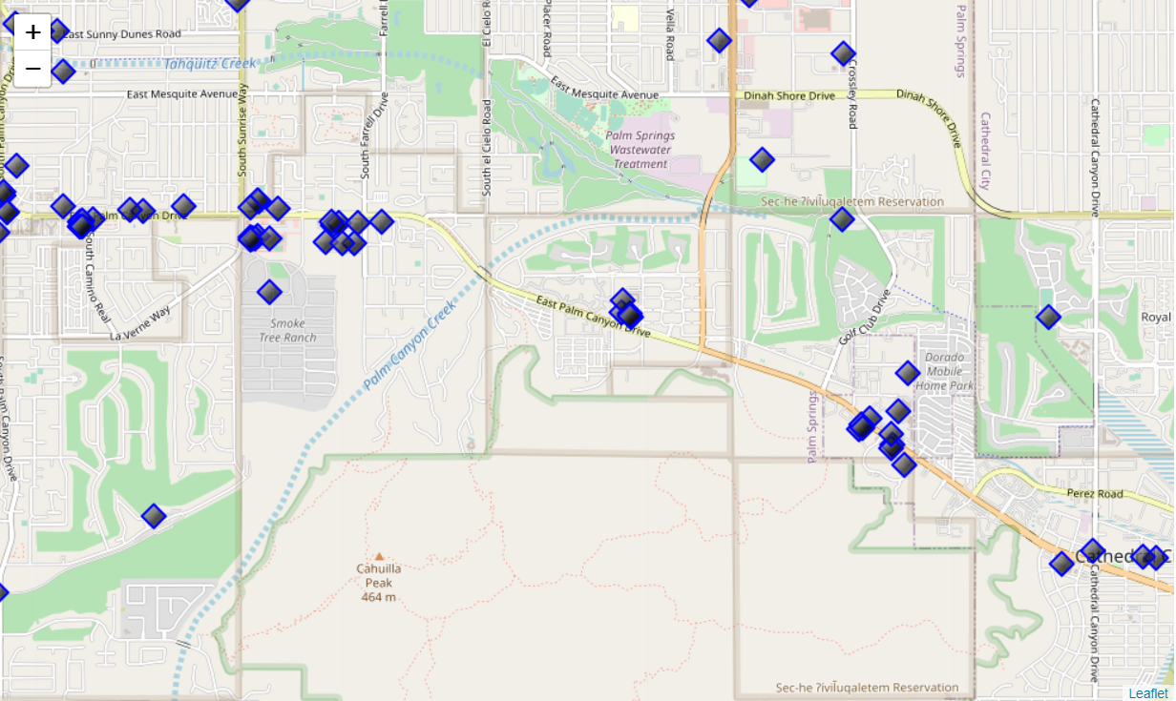
Map of City Center Neighborhood

Slide 9
Methodology
The methodology we have used was to utilize Foursquare to analyse the chosen neighborhood and create a breakdown of businesses types and numbers in the chosen area. The idea behind this, is that if we know the numbers and types of restaurants and franchises already present there, it will allow us to decide on which type of new restaurant would be the most welcome with the least amount of competition in that type of food.

Slide 10
Discussion
It was found that some types of restaurant and franchise where far more common than others.
In particular:
Starbucks 2
Moorten Botanical Garden 1
Swiss Donut 1
ALDI 1
Others were less clear, since there are several Mexican restaurants in the area which the data makes harder to count. In the main however, business showed a good spread of uniqueness, and where mostly one of a kind in that area.

Slide 11
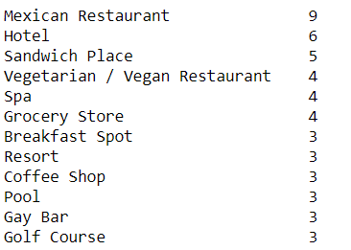
Conclusion
A lot of useful information about the area was derived from the data. It was found that by applying Data Science techniques the area was found suitable for opening an up-market restaurant, main competition (in the form of other dining establishments) comes from the Mexican restaurants and Fast Food.

